Slide 1
Presentation 3
Software quality factors
The need for comprehensive software quality requirements
Classification of requirements into software quality factors
Product operation factors
Product revision factors
Product transition factors
Alternative models of software quality factors
Who is interested in defining quality requirements?
Software compliance with quality factors

Slide 2
McCall's software quality
factors model
Software quality factors
Product operation factors
Product revision factors
Product transition factors

Slide 3
Requirement Document
A comprehensive definition of requirement
The need to define requirement that belong to each quality factor
Requirement documents are expected to differ in the emphasis placed on the various factors. (Sometimes for comparisons)
Not all the factors will be represented.

Slide 4
Product operation factors
Correctness
Reliability
Efficiency
Integrity
Usability

Slide 5
Correctness
Defined in a list of the software system’s required outputs.
Output specifications are usually multidimensional, including:
- output mission
- required accuracy of the outputs
- the completeness of the output information
- the up-to-dateness of the information
- the availability of the information
- the standards for coding & documenting

Slide 6
Reliability
Deals with failures to provide services.
Usually refer to the maximum allowed software system failure rate that can be the entire system or one or more of its functions.

Slide 7
Efficiency
Deals with the hardware resources needed to perform all the functions
May include the maximum values at which the hardware resources will be applied in the software system.
May also deal with the time between recharging of the system’s units.

Slide 8
Integrity
Deals with the system security, namely, the prevention of the access to unauthorized persons.
Also deals with distinguishing the privilege (read, copy, write, … permit) to the information of the personnel.

Slide 9
Usability
Deals with the scope of staff resources needed to train a new employee and to operate the system.

Slide 10
Product revision factors
Deals with software maintenance activities: corrective
maintenance, adaptive maintenance, perfect maintenance.
Maintainability
Flexibility
Testability

Slide 11
Maintainability
Determines the efforts that will be needed by users and maintenance personnel to identify the reasons for failures, to correct the failures, and to verify the success of correctness.
Refers to modular structure (size), program documentation (standards), manuals, etc.

Slide 12
Flexibility
Refers to the capabilities & efforts required to support adaptive maintenance & perfect maintenance, including human resources, extents of activities, etc.
E.g., The system should be suitable for teachers of all subjects and all school levels.

Slide 13
Testability
Deals with the testing of the system as well as with the operation.
- For ease of testing, such as providing predefined intermediate results and log files.
- For operation, such as automatic diagnostics performed by the system prior to starting the system; automatic generating report about detected faults.
- For maintenance, automatic diagnostic checks applied by maintenance technicians to detect the causes of failures.

Slide 14
Product transition factors
Refers to adaptation to other environments and
interaction with other systems.
Portability
Reusability
Interoperability

Slide 15
Portability
Refers to adaptation to other environments consisting of different hardware, operating systems, and so forth.

Slide 16
Reusability
Deals with the use of software modules originally designed for one project in a new software project being developed.
Can save resources, shorten time and provide higher quality modules.

Slide 17
Interoperability
Focuses on creating interfaces with other software systems or with other equipment firmware.
Can specify the names of the software or firmware for which interface is required.
Can also specify the output structure accepted as standard.

Slide 18
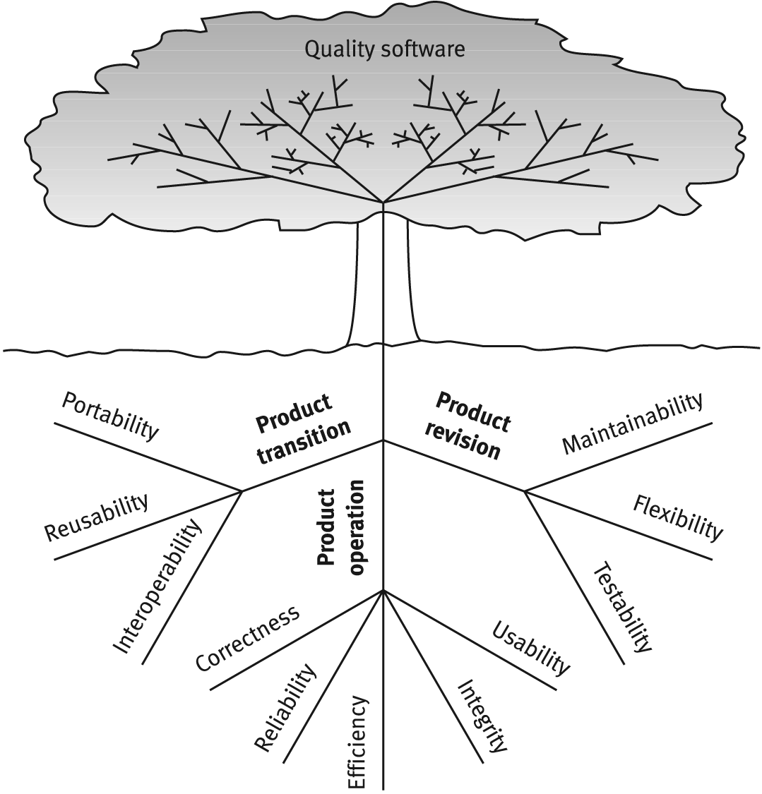
McCalls factor model tree

Slide 19
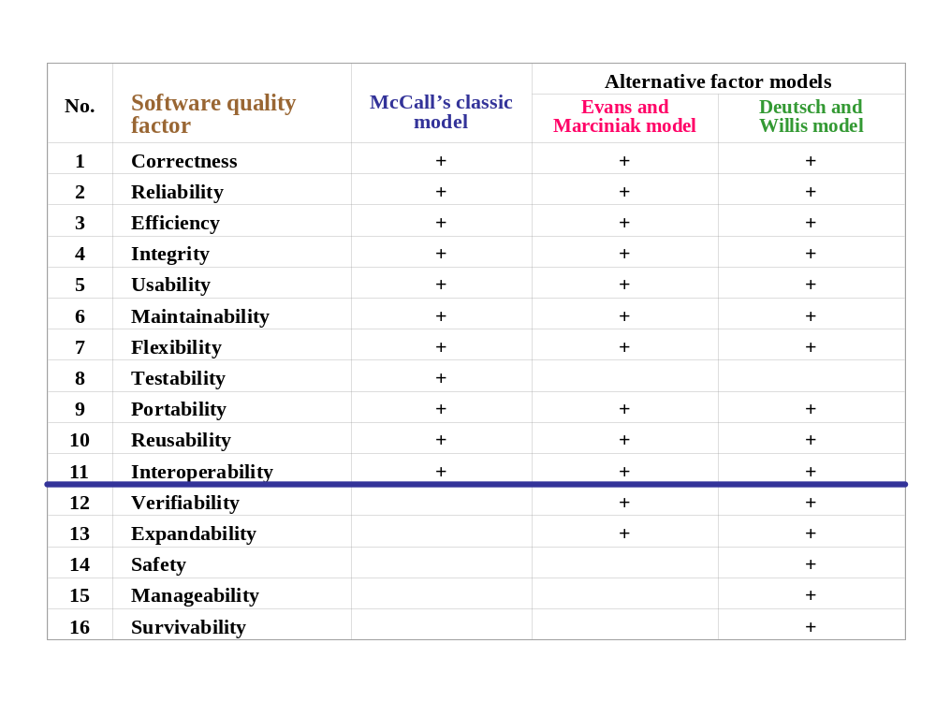
McCall's factor model
and alternative models

Slide 20
Verifiability
Defines design and programming features.
Refer to modularity and simplicity, and adherence to documentation and programming guidelines.
Improves the design reviews and software tests.

Slide 21
Expandability
Refers to future efforts that will be needed to serve larger populations.

Slide 22
Safety
To eliminate conditions hazardous to operations of equipment as a result of errors, including providing alarm signals.

Slide 23
Manageability
Refers to the administrative tools that supports software modification, such as CM.

Slide 24
Survivability
Refers to the continuity of service. These define the minimum time allowed between failures, and the maximum time permitted for recovery of service.

Slide 25
Who is interested in defining quality requirements?
A project will be carried out according to two requirement documents:
- The client’s requirement document
- The developer’s additional requirement document

Slide 26
Software compliance with quality factors
Examine the development process by reviews, inspections, tests, etc.
Verify and validate the quality by measuring.
Sub-factors are defined for quality factors.
Please see Table 3.3 suggested by Evans and Marciniak (1987).

